Slide 1
Report Outline

Slide 2
Key Points
Different ways to model second binding event, any differences?
Importance of ligand/receptor ratio on binding state, links to mechanism of action/previous experimental data.
Synapse model, investigation of prozone effect.

Slide 3
Introduction
Background biology
Different types of antibody therapeutic/different mechanisms/ways of attacking receptors
Experimental paper linking type I/type II antibodies to valency
Importance of avidity/links to bispecifics
Introduce ways to ideas of modelling second binding event

Slide 4
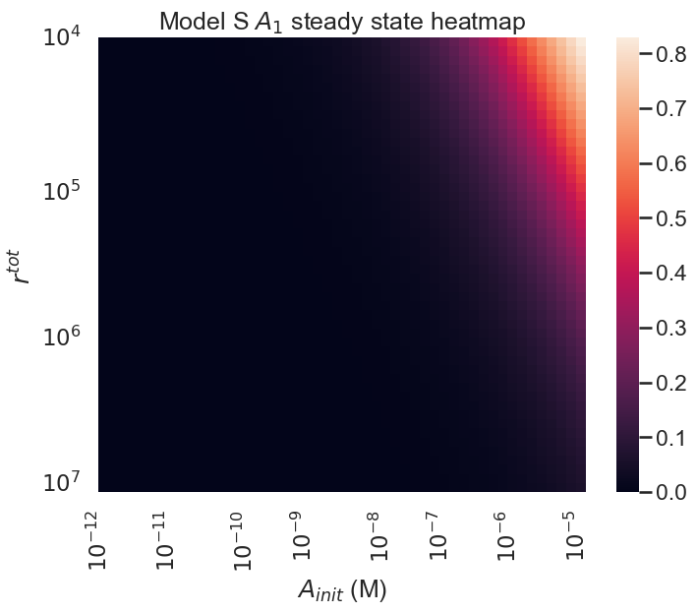
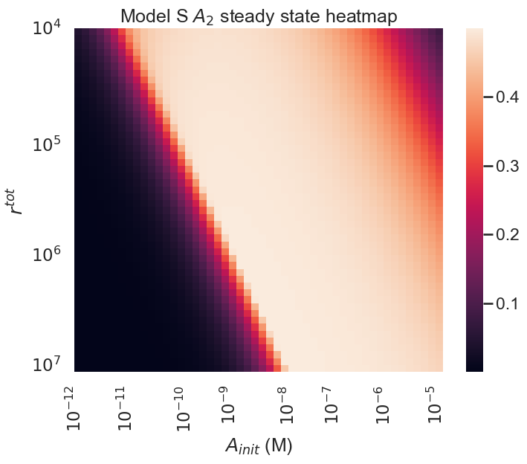
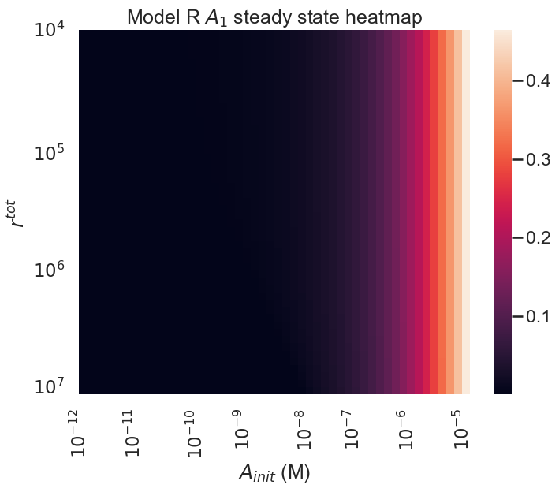
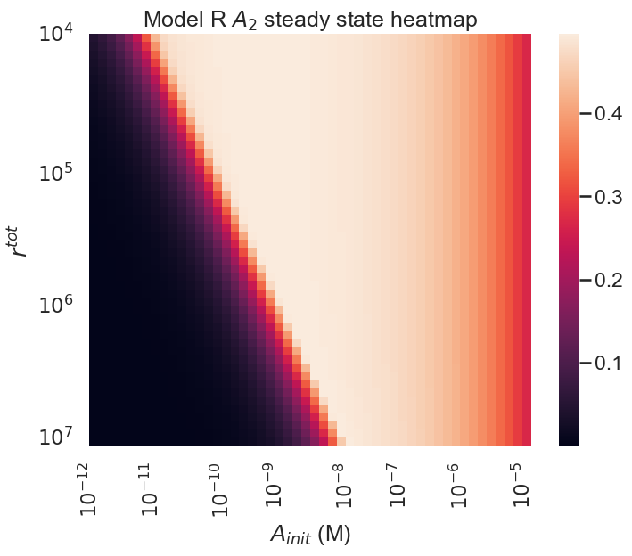
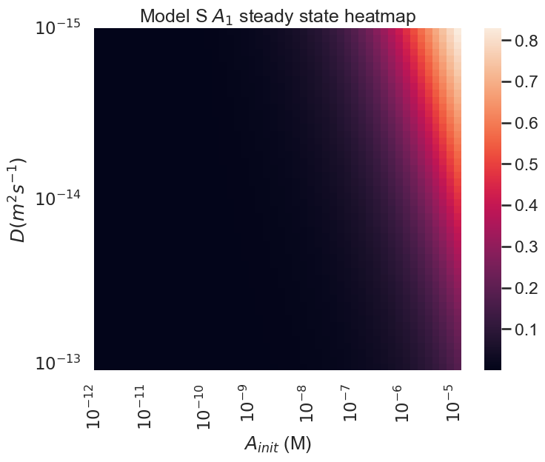
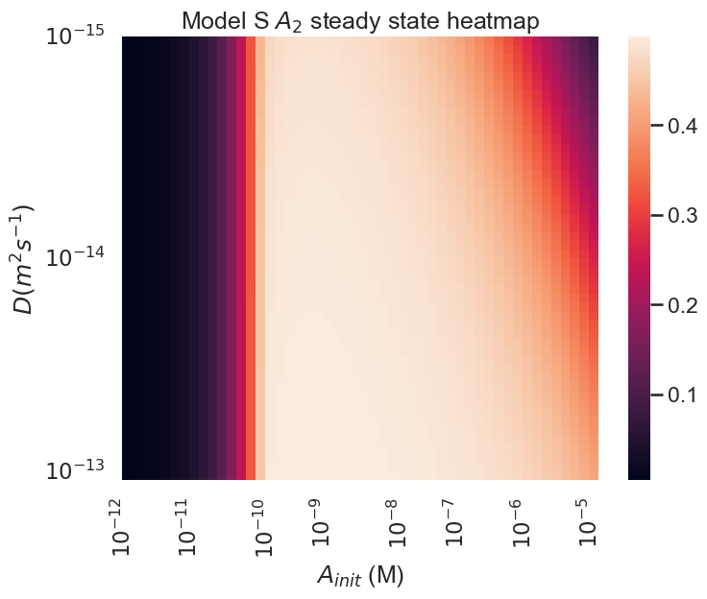
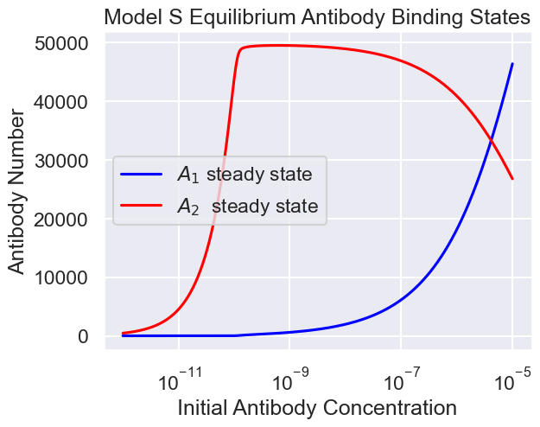
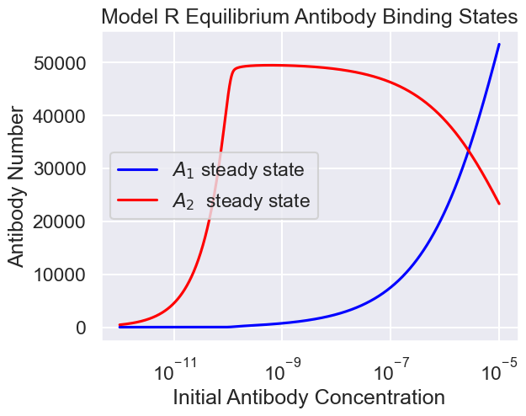
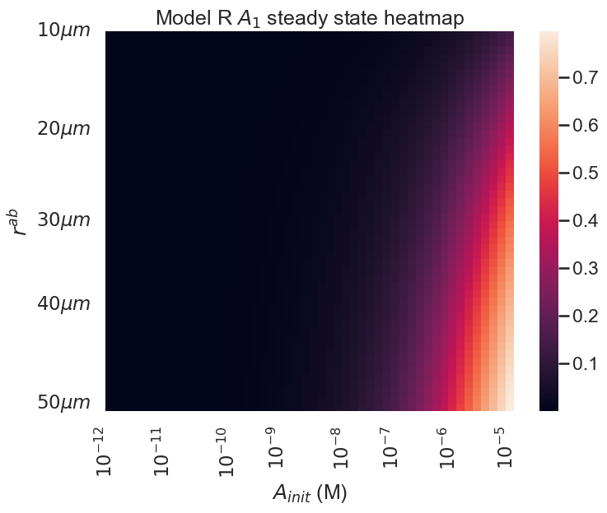
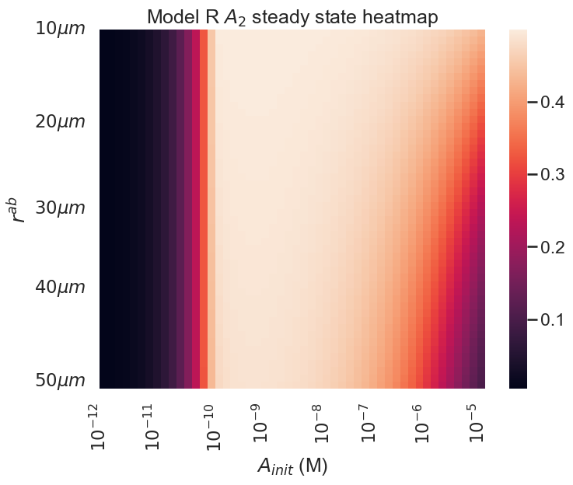
Model S and R comparison
Model Introductions
Steady States: general example figure, heatmaps
Sensitivity Analyses: receptor occupancy/ number of antibodies

Slide 5
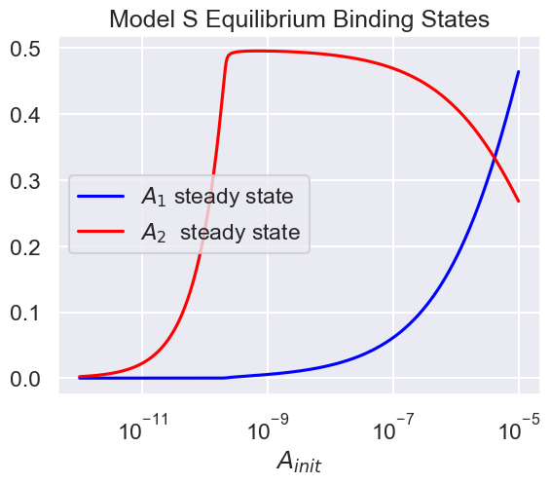
Take away: both models show similar steady state behavior (dose dependent binding state)

Slide 6
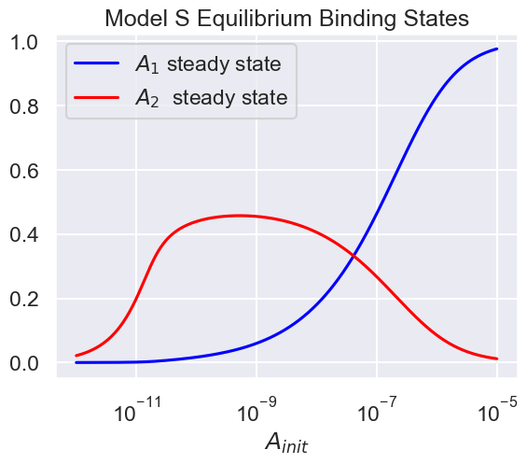
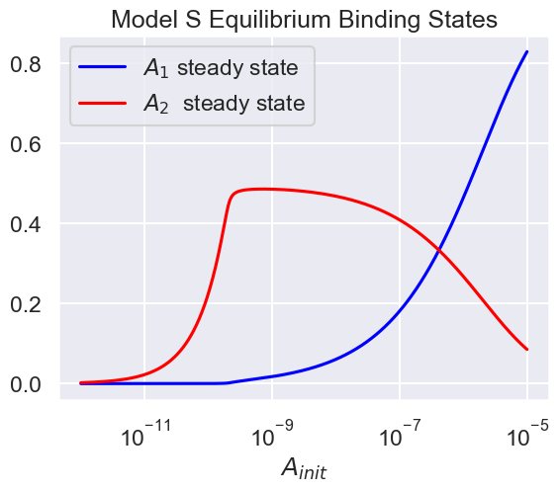
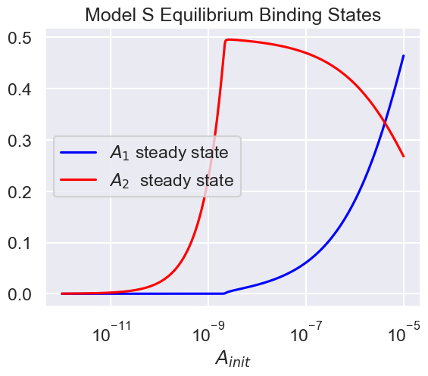
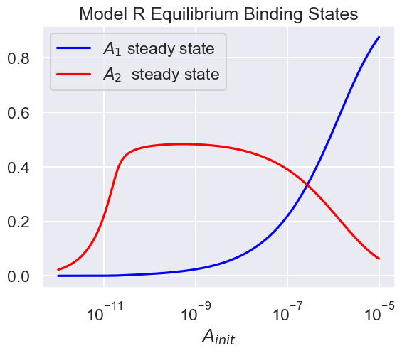
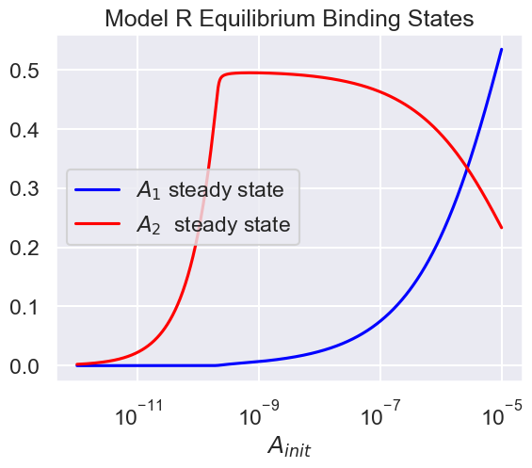
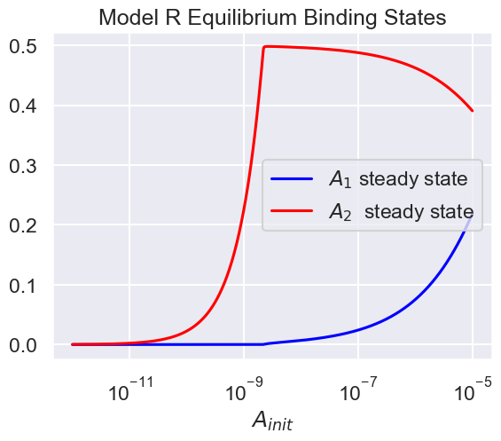
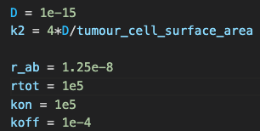
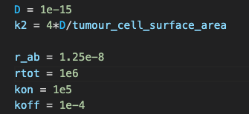

Slide 7
Take away: both models behave as expected when varying main parameter in k2

Slide 8
Take away: binding state sensitive to Atot/rtot ratio (two regimes)
Aside A1

Slide 9
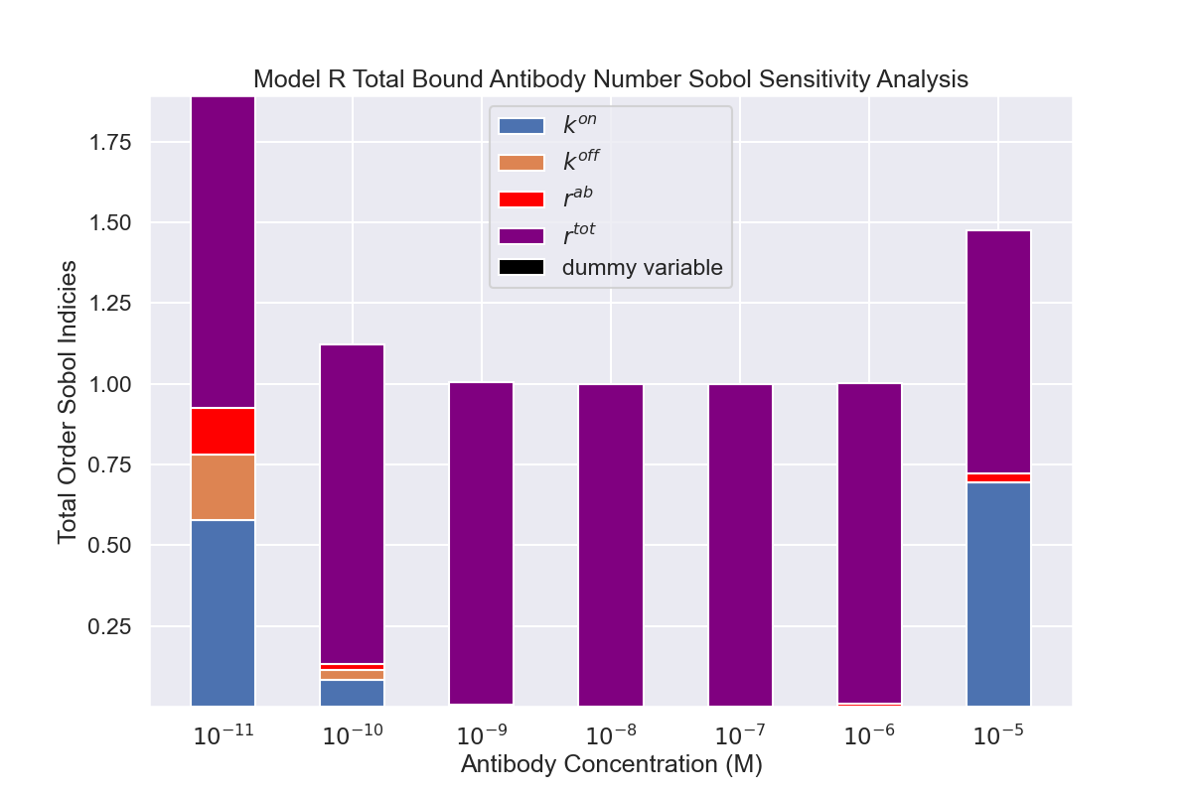
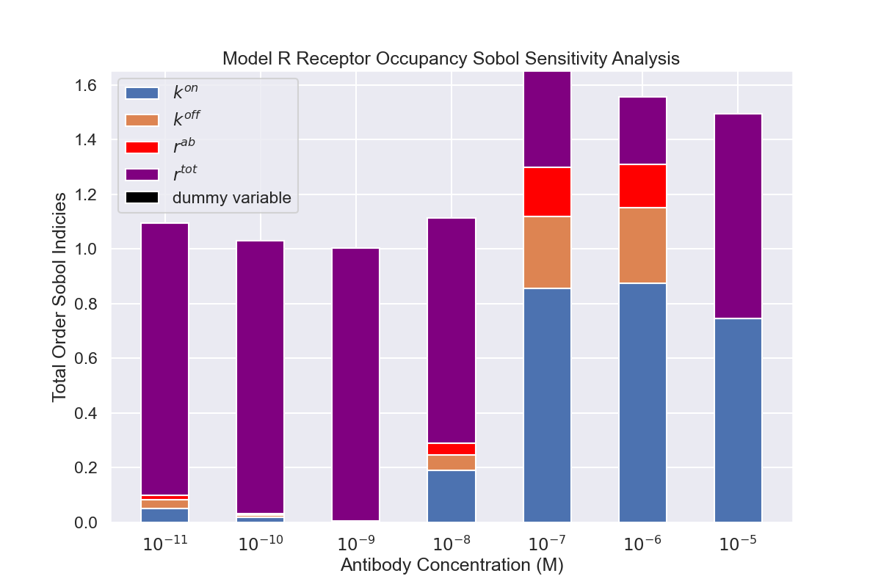
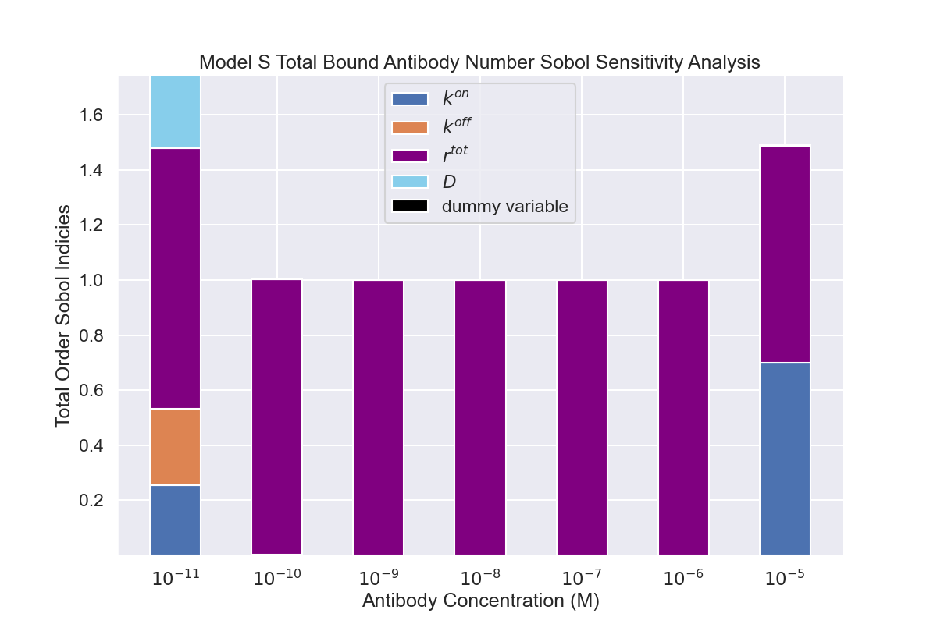
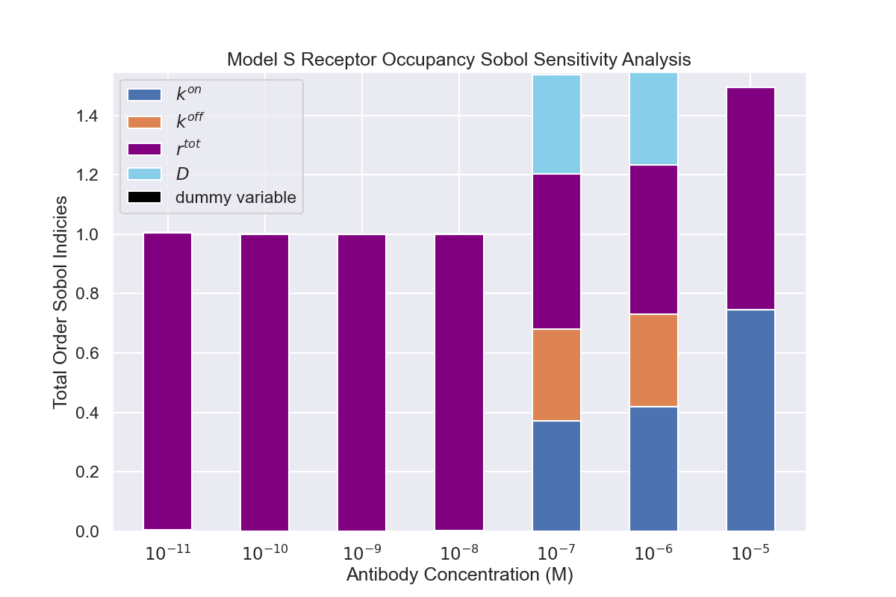

Slide 10
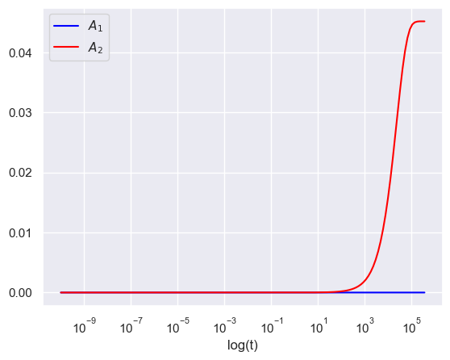
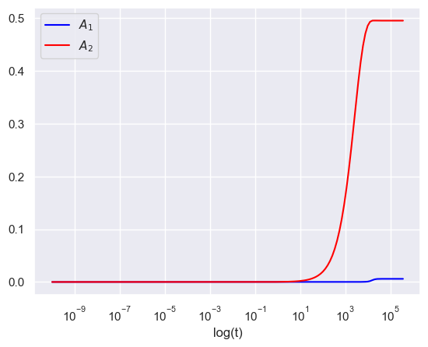
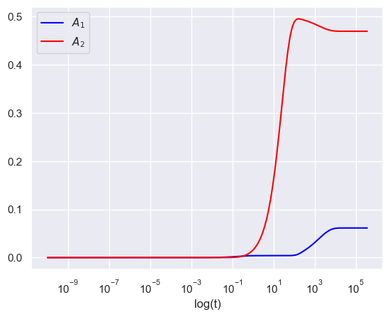
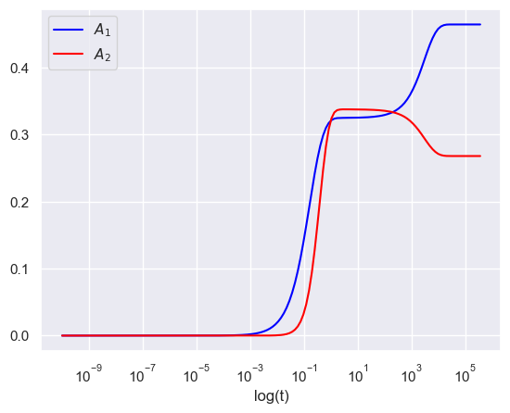
Model Dynamics (dive into two regimes)
Example simulations: simulations from all regimes
Asymptotics
Phase planes?

Slide 11
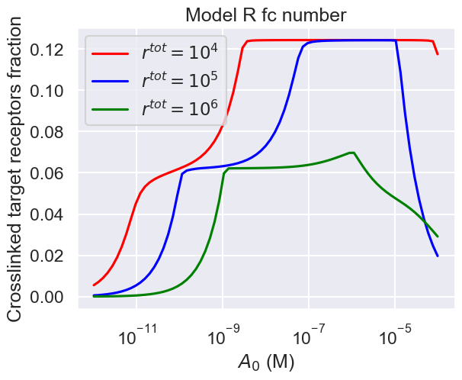
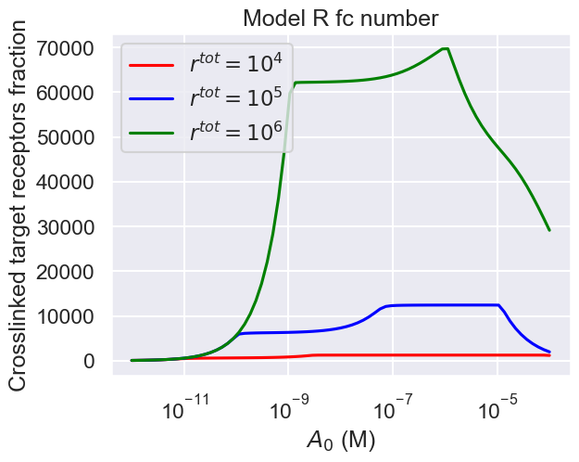
Synapse Model
Introduction/Assumptions/Justifications
Prozone Investigation

Slide 12
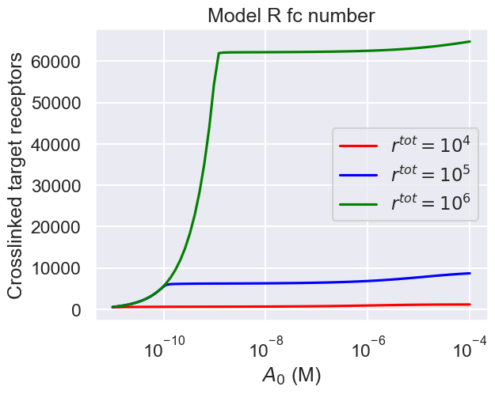
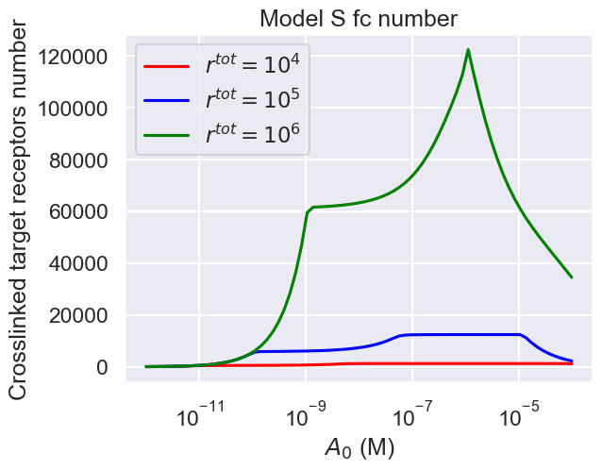
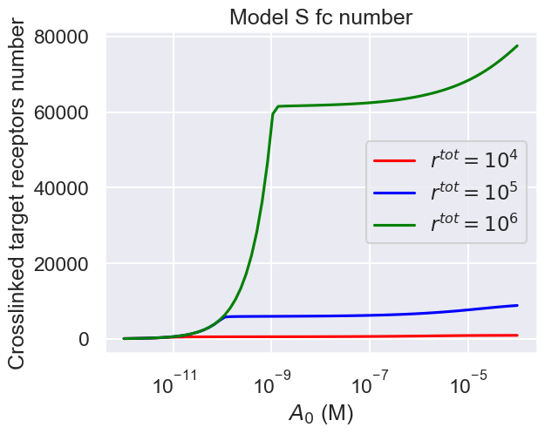
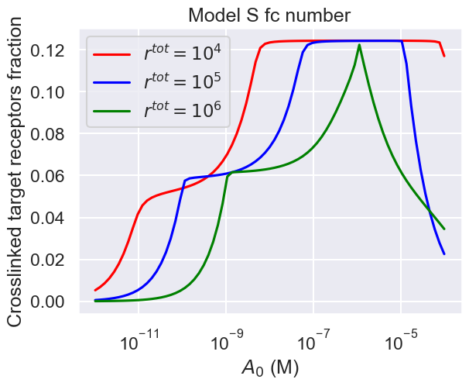
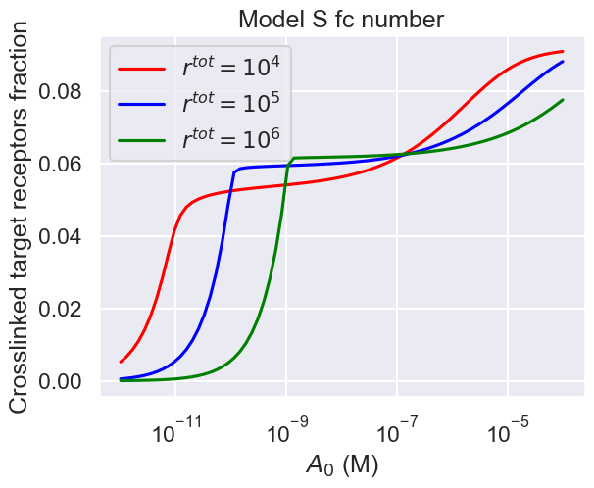
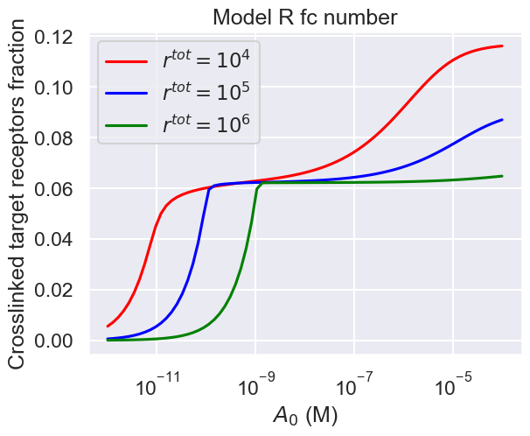

Slide 13
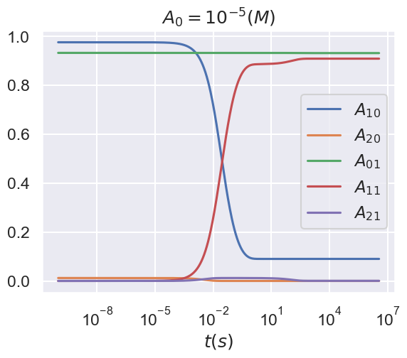
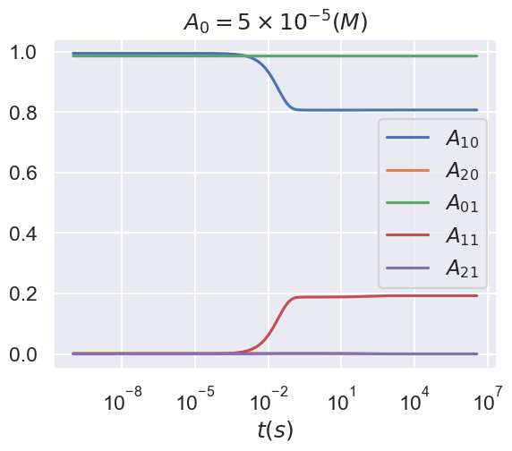

Slide 14
Discussion
Key point 1 (different modelling methodologies):
Both methodologies show same behavior throughout (same steady state dynamics/two regimes/ similar sensitivity analyses.
Maybe more room for wider behavior in model S because can vary D but can’t vary r^ab with model R
Both models structurally identifiable
Scope to combine models/biologically model S makes sense for low receptor densities and vice versa for R
Key point 2 (two binding regimes):
Both models show distinction between small and high Atot/rtot regime (this has been seen experimentally for different types of mab)
Sensitivity analysis shows receptor number is important for small Atot/rtot whereas binding parameters come into play for higher Atot/rtot. Implications for pkpd/mechanism of action.
Dynamics show separation of timescales dependent on Atot/rtot

Slide 15
Key point 3 (prozone effect):
Synapse model is cool (maybe slightly basic in some assumptions) can be used in a multiscale model of fc dependent effector functions
Both model types display prozone effect (assuming #fc correlates with effector function)
Model indicates prozone effect is due to antibodies clogging up effector cell fc receptors before formation of synapse (no prozone effect seen if effector cell is assumed to not bind any Ab before)
Ratio of fc to target receptor effects "severity” of drop off (very high Ab concentration needed in low rtot setting)

